Slide 1
FPGA Bitstream Security: A Day in the Life
¹Adam Duncan, ²Fahim Rahman, ¹Andrew Lukefahr, ²Farimah Faramandi, ²Mark Tehranipoor
adamdunc@iu.edu
¹Indiana University
²University of Florida

Slide 2
Outline
FPGA Background
Five Bitstream Stages
Attacks
Countermeasures
Future FPGA Bitstream Security
Conclusion

Slide 3
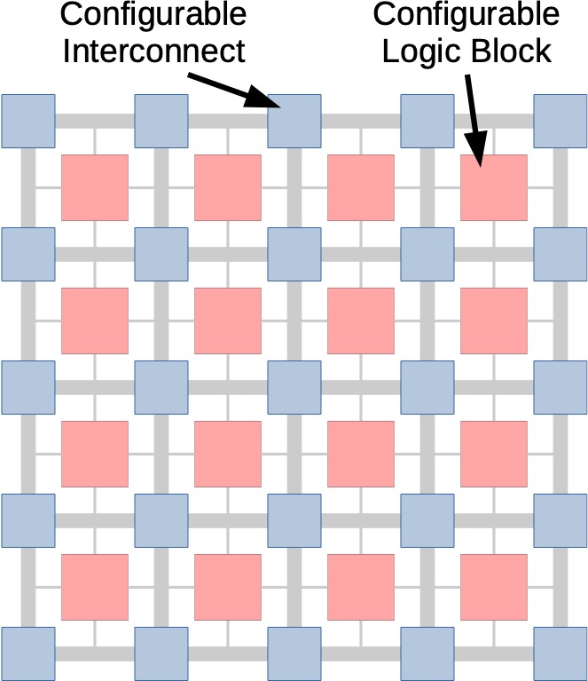
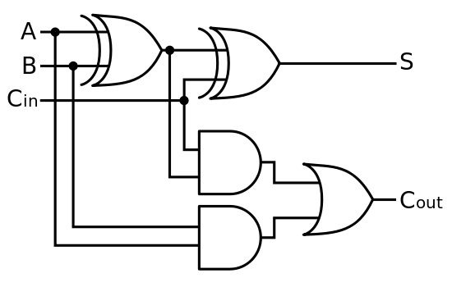
FPGA: Field Programmable Gate Array
Map
FPGAs implement custom digital hardware

Slide 4
FPGA Usage is Growing…
Benefits:
Reconfigurable
Short development times
Low NRE costs
Simplified design flows
Close to ASIC performance
Total Cost
ASIC
FPGA
NRE
28 nm
16 nm
Number of Units
Xilinx FY19 revenue = $3.09B
Figure: Adapted from Trimberger2014 “Three ages of FPGAs”

Slide 5

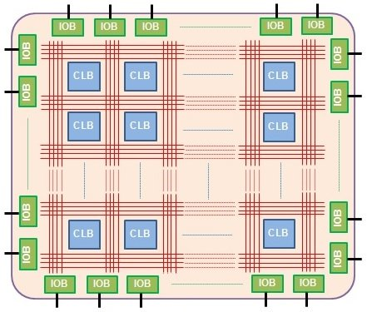


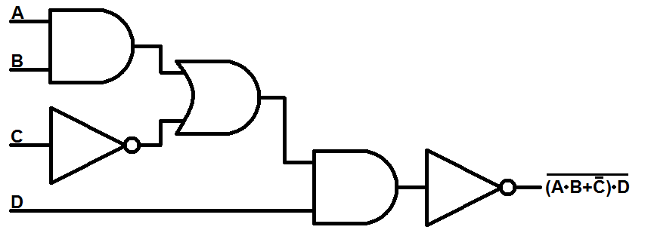
Historical FPGA Design Flow
FPGA
Manufacturer
FPGA
Bitstream Development Software
Bitstream
User
Design

Slide 6
Current FPGA Design Flow
FPGA
Manufacturer
FPGA
Bitstream Development Software
Bitstream
3PIP Design
House
System Integrator
System Programmer
System In-Field
Recycler
(E-Waste)
In-House IP

Slide 7
Bitstream Stages
Entities
3PIP Design
House
System Integrator
System Programmer
System In-Field
Recycler
(E-Waste)
In-House IP
Stages
Bitstream-Generation
Bitstream-at-Rest
Bitstream-Loading
Bitstream- Running
Bitstream-EOL and Counterfeiting
We define five bitstream stages

Slide 8
Bitstream Stages Interaction
Entities
3PIP Design
House
System Integrator
System Programmer
System In-Field
Recycler
(E-Waste)
In-House IP
Design Changes
Bitstream Compiled
Functional Test
Design Changes
Design Checkpoints
Bitstream to NVM
System Decommissioned
PCB Extraction
Bitstream in NVM
Remote
Upgrade
System Operating
Booting from NVM
Stages
Bitstream-Generation
Bitstream-at-Rest
Bitstream-Loading
Bitstream- Running
Bitstream-EOL and Counterfeiting
Complicated interactions…
Let’s focus on bitstream stages

Slide 9
Bitstream Stages + Threats
Entities
3PIP Design
House
System Integrator
System Programmer
System In-Field
Recycler
(E-Waste)
In-House IP
Design Changes
Bitstream Compiled
Functional Test
Design Changes
Design Checkpoints
Bitstream to NVM
System Decommissioned
PCB Extraction
Bitstream in NVM
Remote
Upgrade
System Operating
Booting from NVM
Stages
Bitstream-Generation
Bitstream-at-Rest
Bitstream-Loading
Bitstream- Running
Bitstream-EOL and Counterfeiting
Malicious Intent
Bitstream Tampering
Side Channel Attacks
Fault Injection
Bitstream
Remanence
Threats
Non-Malicious
Intent
IP
Piracy
Replay
Attacks
Run-time Attacks
Counterfeit
FPGAs

Slide 10
Bitstream-Generation
Entities
3PIP Design
House
System Integrator
System Programmer
System In-Field
Recycler
(E-Waste)
In-House IP
Design Changes
Design Changes
Design Checkpoints
Stages
Bitstream-Generation
Malicious Intent
Threats
Non-Malicious
Intent

Slide 11
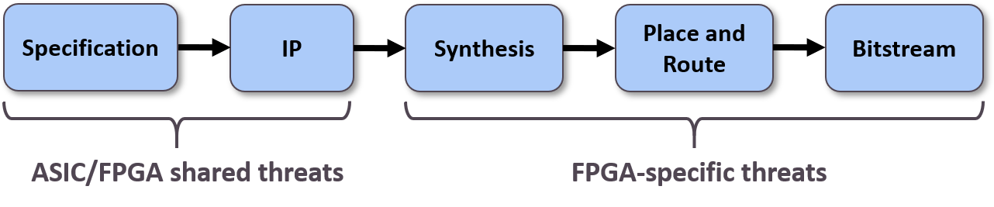
Bitstream-Generation: Flow
Trojan Insertion
IP Piracy
Lookup Tables vs. Standard Cells
Switch Matrices
FPGA-specific threats from synthesis onward

Slide 12
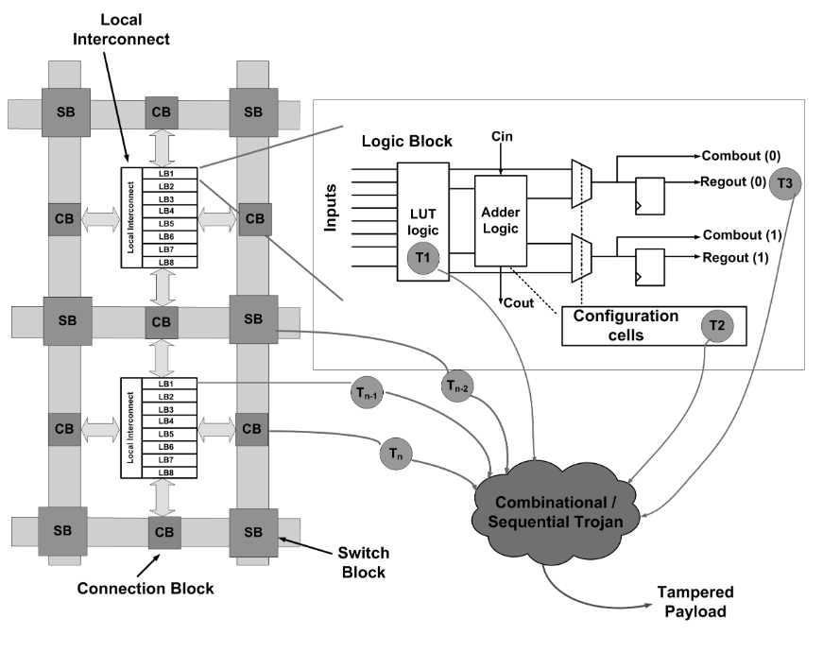
Bitstream-Generation: Attacks
Attack goals:
Modify logic/interconnects
Leak information
Target unused resources
Attack vectors:
Malicious HDL
EDA tool usage
Malicious (Trojan)
Non-malicious (HLS - Leaky Crypto)
FPGA fabric fixed, but configurable…
Multiple Trojan insertion points
Figure: Krieg2016 “Malicious lut: a stealthy fpga trojan injected and triggered by the design flow”

Slide 13
Bitstream-Generation: Countermeasures
EDA tool level:
Best software practices
RTL level:
Trojan detection (rare nodes)
IP encryption (IEEE p1735)
Logic block level:
RTL Logic locking
Fill unused area and test (BISA)
Physically unclonable functions (PUFs)
IP functionality tied to FPGA silicon properties (PUF)
Figure: Zhang2015 “A puf-fsm binding scheme forfpga ip protection and pay-per-device licensing”

Slide 14
Bitstream-at-Rest
Entities
3PIP Design
House
System Integrator
System Programmer
System In-Field
Recycler
(E-Waste)
In-House IP
Design Changes
Bitstream Compiled
Functional Test
Design Changes
Design Checkpoints
Bitstream to NVM
Bitstream in NVM
Stages
Bitstream-at-Rest
Bitstream Tampering
Threats
IP
Piracy

Slide 15
Bitstream-at-Rest: Attacks
Vendor bitstream protections:
Encryption/Authentication
Vendor-proprietary formatting
Bitstream attacks:
Tamper bitstream
Add malicious content
Bypass licensing
Extract IP from bitstream
Steal IP
Overproduction
Bitstream to netlist
Figure: Zhang2019 “A comprehensive fpga reverse engineering tool-chain: From bitstream to rtl code”

Slide 16
Bitstream-at-Rest: Countermeasures
Vendor hardware level:
Encryption
Authentication
On-chip bitstream storage
RTL level:
Watermarks
Logic block level:
Bitstream-level logic locking
Red key decrypts.
Black key stored in FPGA.
Figure: Peterson2018, “Xapp1323: Developing tamper-resistant designs with zynq ultrascale+ devices”

Slide 17
Bitstream-Loading
Entities
3PIP Design
House
System Integrator
System Programmer
System In-Field
Recycler
(E-Waste)
In-House IP
Functional Test
Booting from NVM
Stages
Bitstream-Loading
Side Channel Attacks
Threats
Replay
Attacks

Slide 18
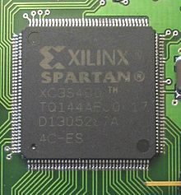
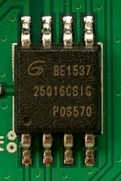



Bitstream-Loading: FPGA Memory Types
Best Bitstream Security
Best Performance
“Store in FPGA”
“Store in Memory IC”
Bitstream
FPGA
FPGA
Bitstream
Memory IC
Flash: 0.5M Logic Gates​, 28 nm
Antifuse: 2M Logic Gates, 150 nm
SRAM: 90M Logic Gates, 16 nm
~90% FPGA market share
What about emerging non-volatile memories?

Slide 19
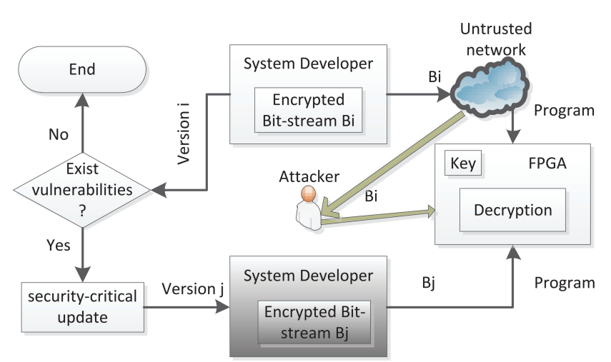
Bitstream-Loading: Attacks
Side channel attacks:
Power, timing, imaging
Information Leakage
Replay attacks:
Load old bitstream to expose vulnerability
Replay attack loads older vulnerable bitstream
Figure: Zhang2015 “Reconfigurable Binding against FPGA Replay Attacks”

Slide 20
Bitstream-Loading: Countermeasures
Vendor hardware level:
Encrypted FSBL
Side channel defenses
Vendor software level:
Bitstream versioning
User level:
Custom FSBL
Encrypted FSBL Authentication
Encrypted FSBL Authentication
Figure: Peterson2018, “Xapp1323: Developing tamper-resistant designs with zynq ultrascale+ devices”

Slide 21
Bitstream-Running
Entities
3PIP Design
House
System Integrator
System Programmer
System In-Field
Recycler
(E-Waste)
In-House IP
Remote
Upgrade
System Operating
Stages
Bitstream- Running
Fault Injection
Threats
Run-time Attacks

Slide 22
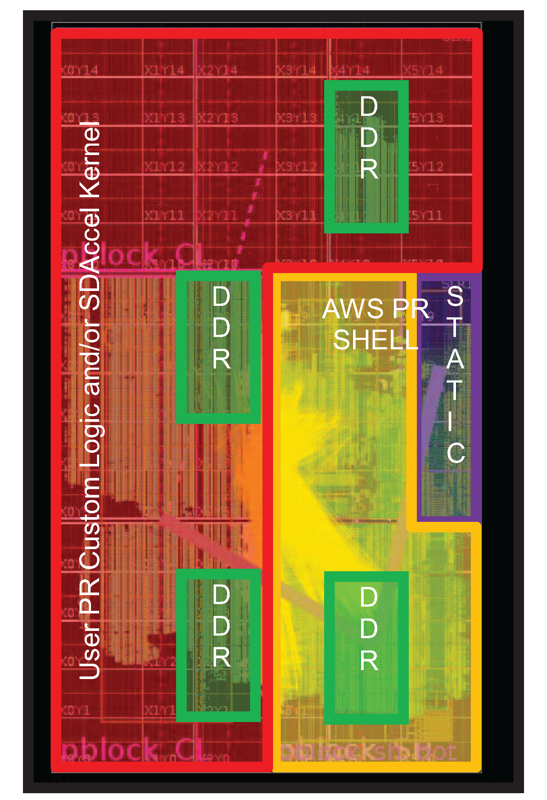
Bitstream-Running: Attacks
Fault injection:
Glitches (power, clock, EM, laser, temperature)
Bit errors (ionizing radiation)
Run-time threats:
Partial reconfiguration
Shared tenancy
AWS shared tenancy
Shared power distribution network (PDN) attack
Figure: Trimberger2017, “Security of FPGAs in Data Centers”
Figure: Schellenberg2018, “An inside job: Remote power analysis attacks on fpgas”

Slide 23
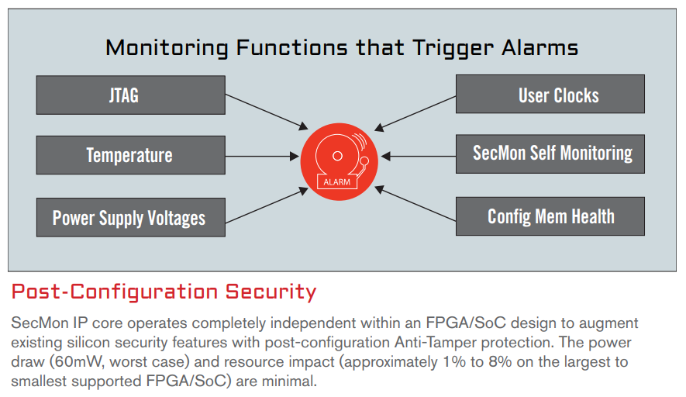
Bitstream-Running: Countermeasures
Vendor hardware level:
Sensors (temperature, voltage, …)
Side channel defenses
Configuration memory hashing
Vendor software level:
Bitstream screening
Vulnerable node identification
User level:
Tamper-resistant designs
Partial reconfiguration hashing
Tamper detection IP cores
Xilinx Secmon Tamper detection IP core
Figure: Xilinx2015, “Security monitor ip core product brief”

Slide 24
Bitstream-EOL
Entities
3PIP Design
House
System Integrator
System Programmer
System In-Field
Recycler
(E-Waste)
In-House IP
System Decommissioned
PCB Extraction
Stages
Bitstream-EOL and Counterfeiting
Bitstream
Remanence
Threats
Counterfeit
FPGAs

Slide 25
Bitstream-EOL: Attacks
Bitstream remanence:
Bitstream still on board NVM
Bitstream still on Flash/antifuse FPGA
FPGA counterfeits:
Harvested from e-waste
Remarked legacy devices
FPGAs = 20% of counterfeits
Figure: Akhoundov2018, “2017 erai reported parts analysis”

Slide 26
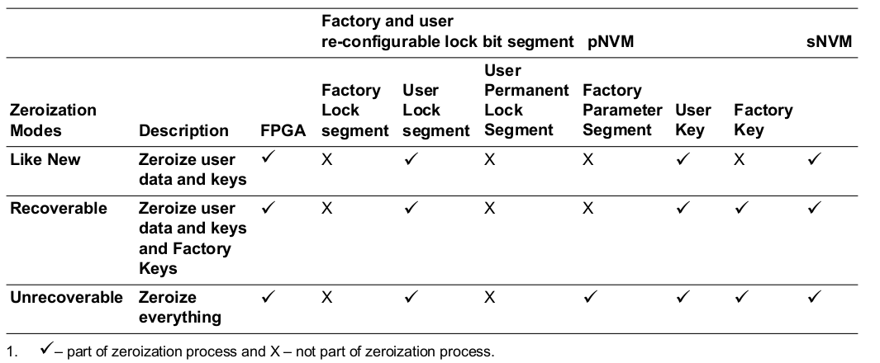
Bitstream-EOL: Countermeasures
Vendor hardware level:
Bitstream zeroization
Key zeroization
Supply chain tracking keys
Vendor software level:
Supply chain tracking
Segmented locking
User level:
Partial reconfiguration for zeroization
Aging detection
Microsemi zeroization options
Figure: Microsemi2018, “Polarfire FPGA security user guide”

Slide 27
Future FPGA Bitstream Security
FPGA memory technologies:
Currently: SRAM/Flash/antifuse
Trending: Nonvolatile MRAM/ReRAM
Impact: Improved bitstream storage security? New physical attacks?
Advanced FPGA packaging:
Currently: FPGA and FPGA SoCs
Trending: Tiling, MCP
Impact: Reduced physical attack surface? Untrusted ICs in package?

Slide 28
Future FPGA Bitstream Security
FPGA bitstream initialization and upgrade:
Currently: ISP physically connected to FPGA
Trending: Remotely loading, updating and authenticating bitstreams
Impact: Improved programming times? New bitstream tampering attacks?
Multi-FPGA systems and shared tenancy:
Currently: Single FPGA or SoC FPGA per system
Trending: Multiple FPGAs in system, multiple users sharing FPGA resources
Impact: Improved system time-to-market? Shared FPGA resource attacks?

Slide 29
Conclusion
Bitstream Stages:
Bitstream-Generation
Bitstream-at-Rest
Bitstream-Loading
Bitstream-Running
Bitstream-EOL
Robust FPGA security should consider protection across all stages

